Slide 1
Chaser 2 — Integration
Rachel VanRyzin, Isabella Knox, 3/20/19

Slide 2
Biggest Successes
Biggest Challenges
Integration of sensing, line follow, and communication into one code
Storage of found quaffles in an array
Reorganizing the code to call functions instead of writing all code in main loop
Troubleshooting the bot (why does she spazz? And hate line follow?)

Slide 3
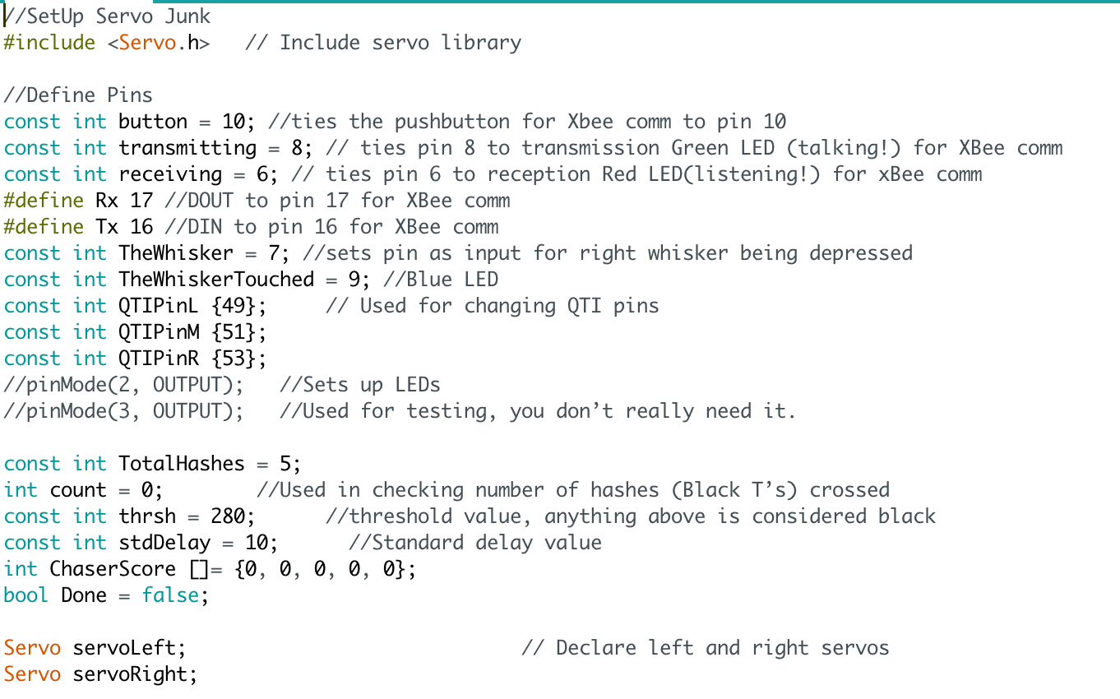
New Code

Slide 4
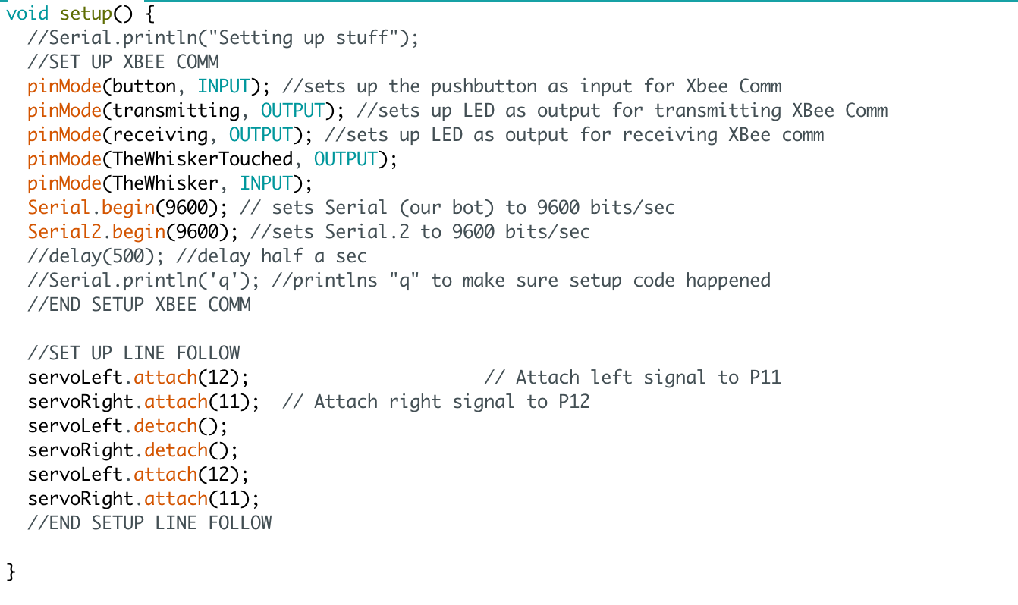

Slide 5
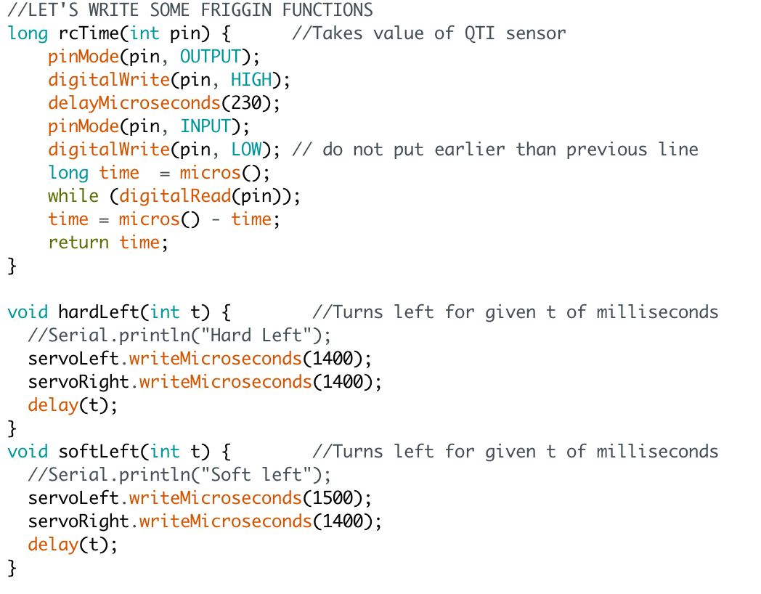

Slide 6
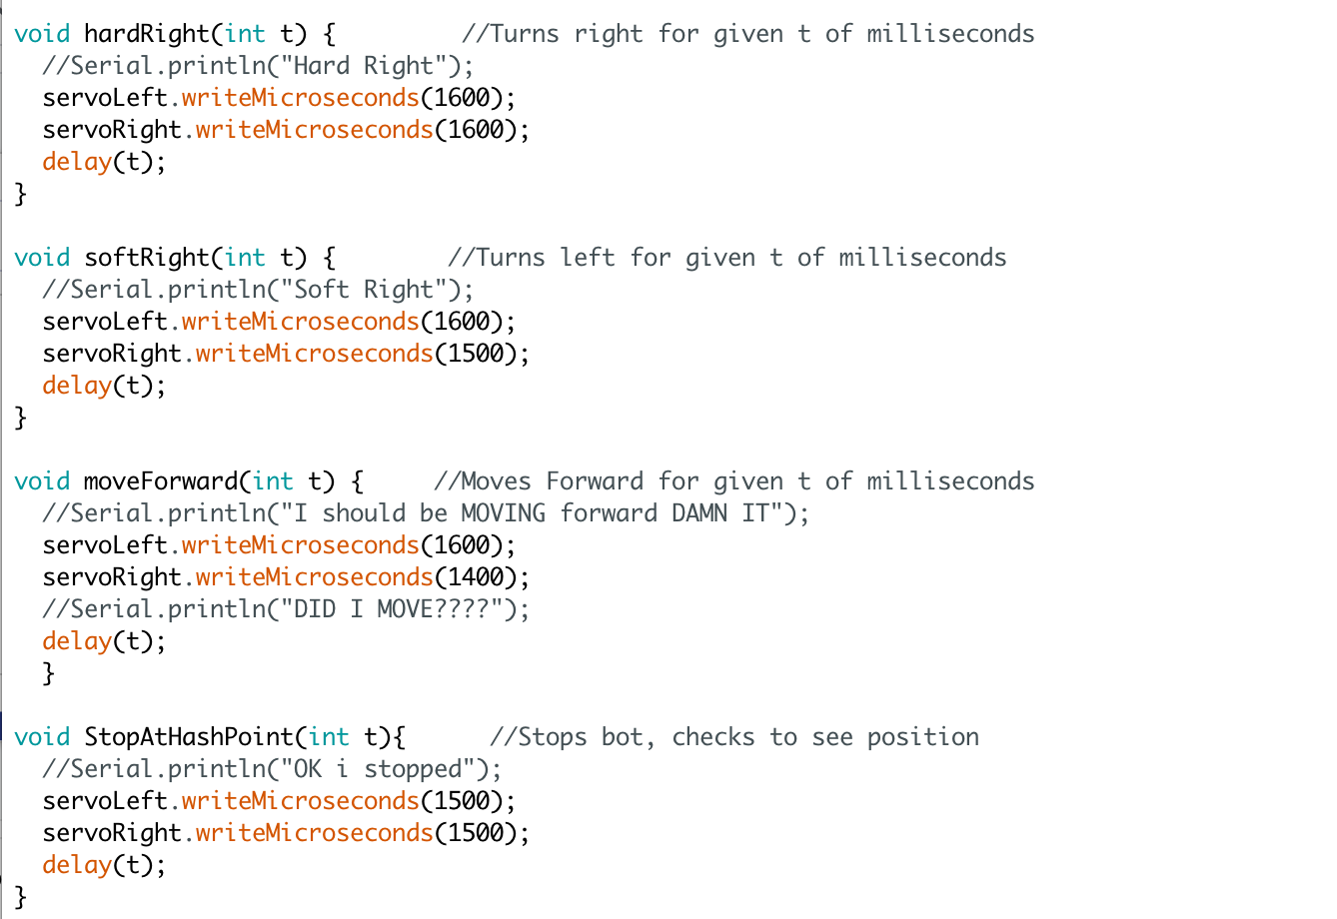

Slide 7
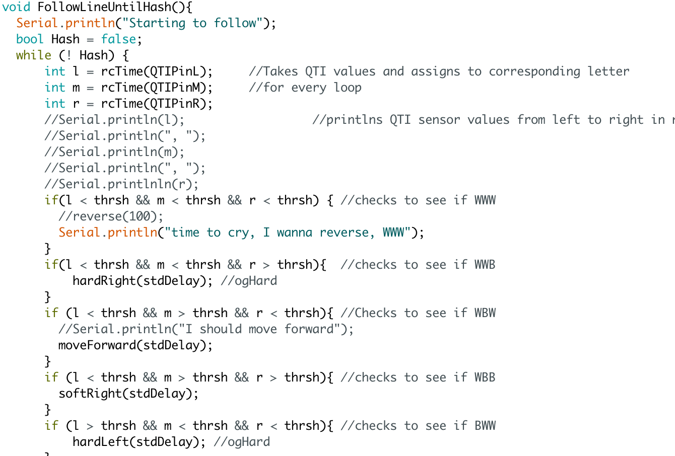

Slide 8
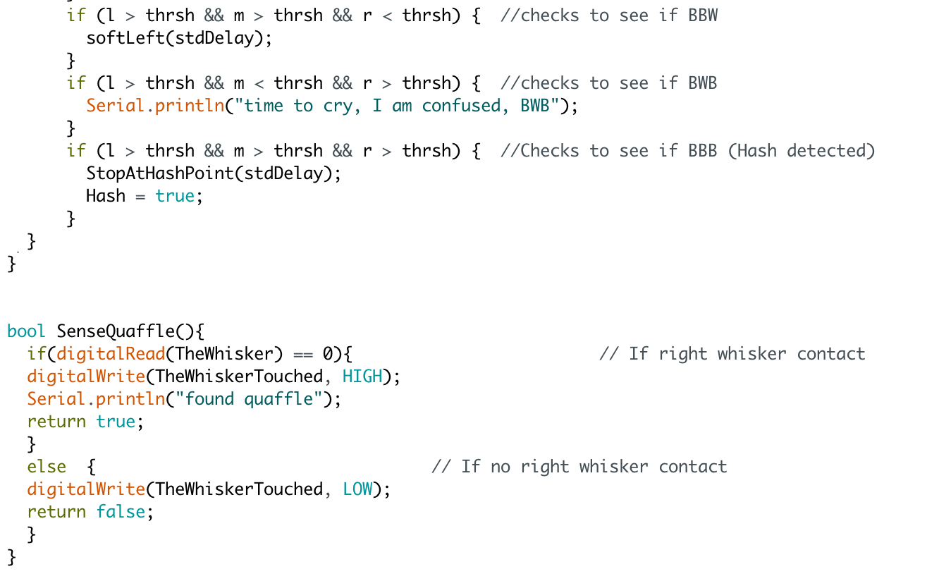

Slide 9
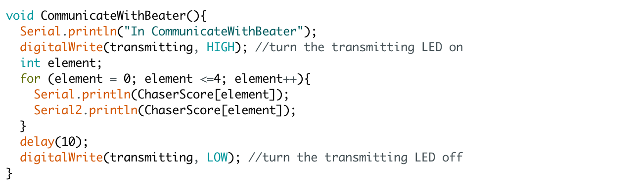

Slide 10
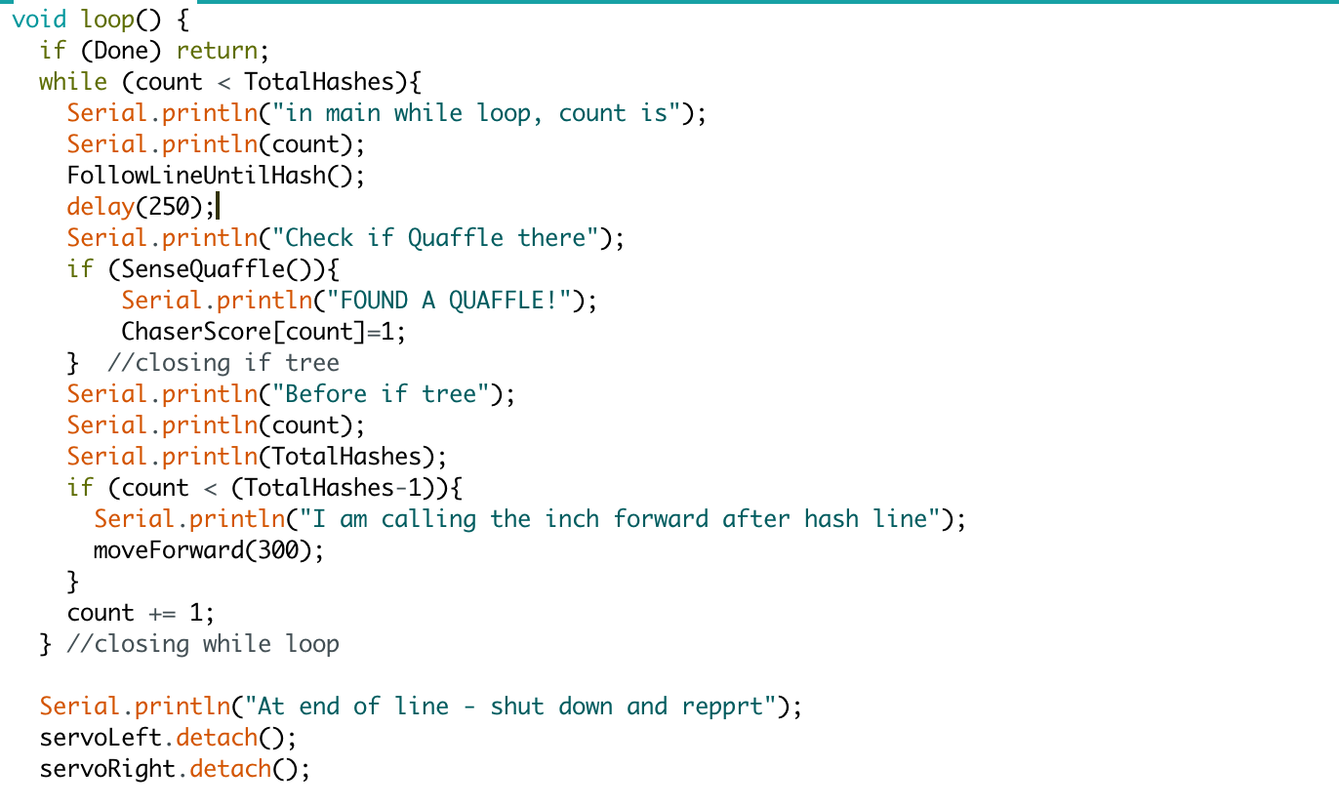

Slide 11
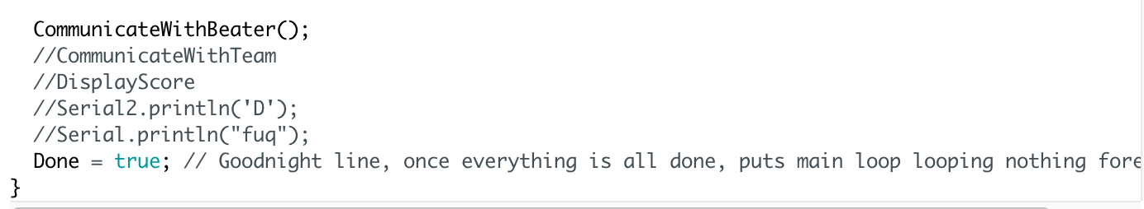

Slide 12
Next Week
Begin working on team communication for score sharing
Begin working on digital display for score

Slide 13
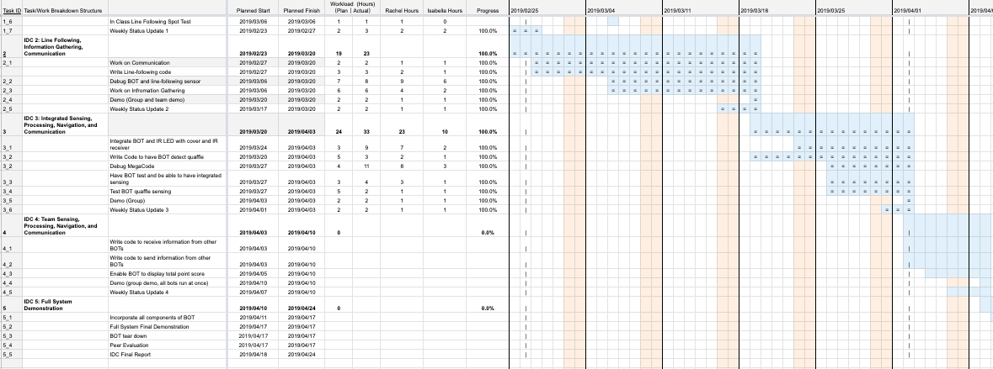
Gantt Chart

Slide 14
Cost Added This Week
Wire, ~0.5 ft = $0.04
Total Cost of parts ON bot: | $35.49
Total Cost of bot and parts: | $234.49

